Slide 1
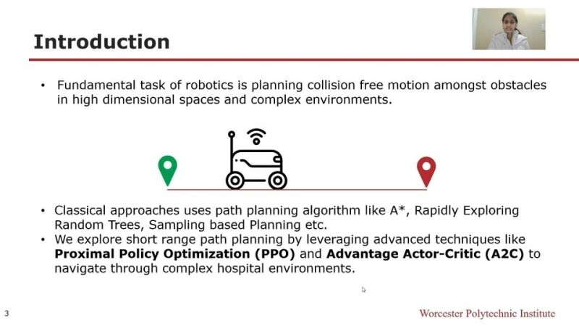

Slide 2
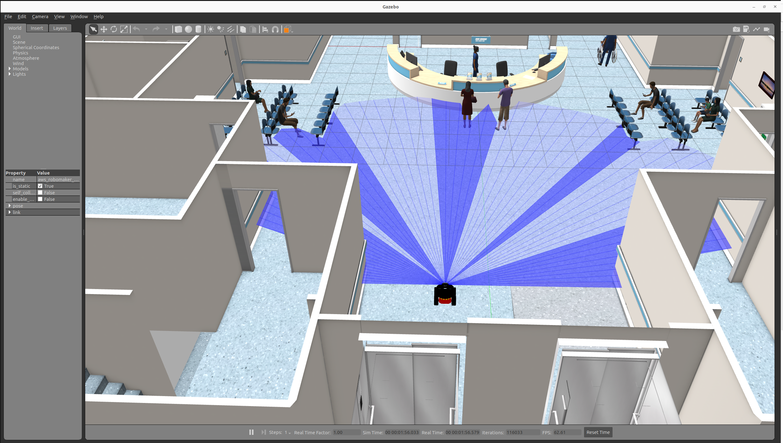
Environment Setup
The environment is a 3D representation of a hospital and is simulated using Gazebo, which integrates seamlessly with ROS2 Humble.
The wheeled mobile robot is placed on the floor of a generic hospital furnished with various objects and even some people.

Slide 3
General Infrastructure
Controls to the
robot
ROS2
Gazebo
Controls and info for RL environment
Sensor Measurements
Info and controls to run algorithm
PPO/A2C
OpenAI Gym

Slide 4
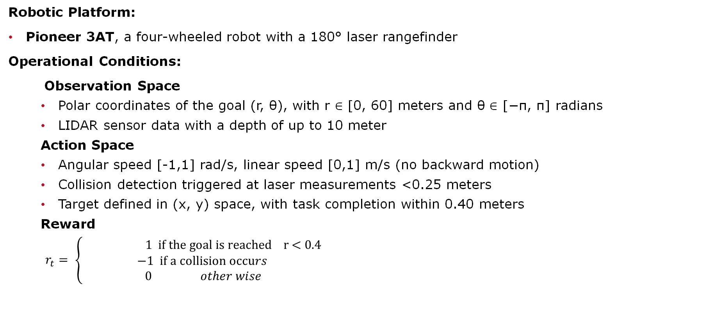
Environment Setup
Robotic Platform:
Pioneer 3AT, a four-wheeled robot with a 180° laser rangefinder
Operational Conditions:
Observation Space
Polar coordinates of the goal (r, θ), with r ∈ [0, 60] meters and θ ∈ [−π, π] radians
LIDAR sensor data with a depth of up to 10 meter
Action Space
Angular speed [-1,1] rad/s, linear speed [0,1] m/s (no backward motion)
Collision detection triggered at laser measurements <0.25 meters
Target defined in (x, y) space, with task completion within 0.40 meters
Reward
$r_{t}= \left\{\begin{aligned}\text{ 1 }\text{if} \text{the} \text{goal} \text{is} \text{reached} \text{r}\text{ < 0.4 } \\ \text{−1 }\text{if} \text{a} \text{collision} \text{occu}rs \\ \text{0} other wise\end{aligned}\right.$
Notes:
Emphasize on Reward

Slide 5
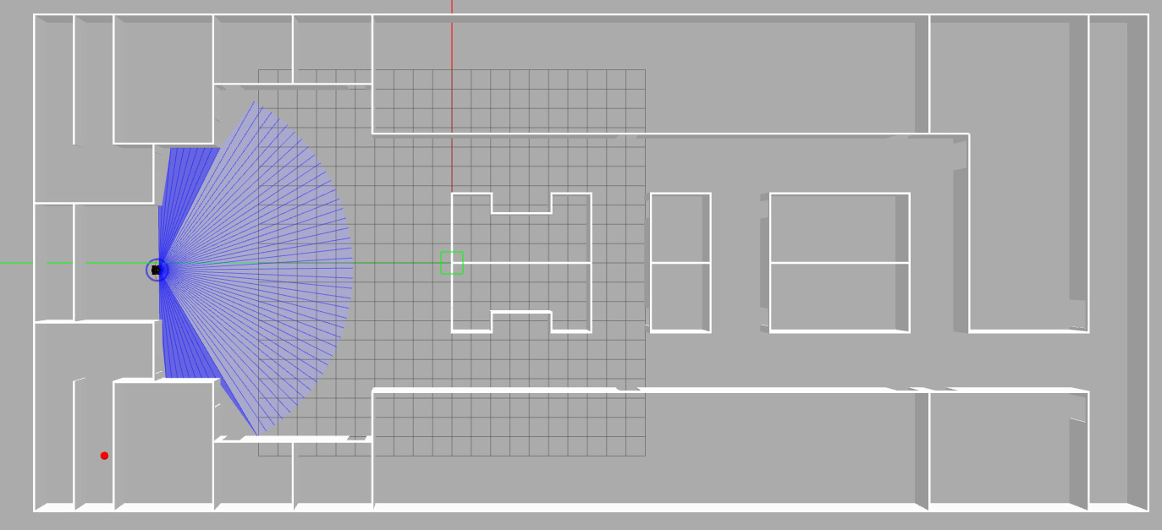
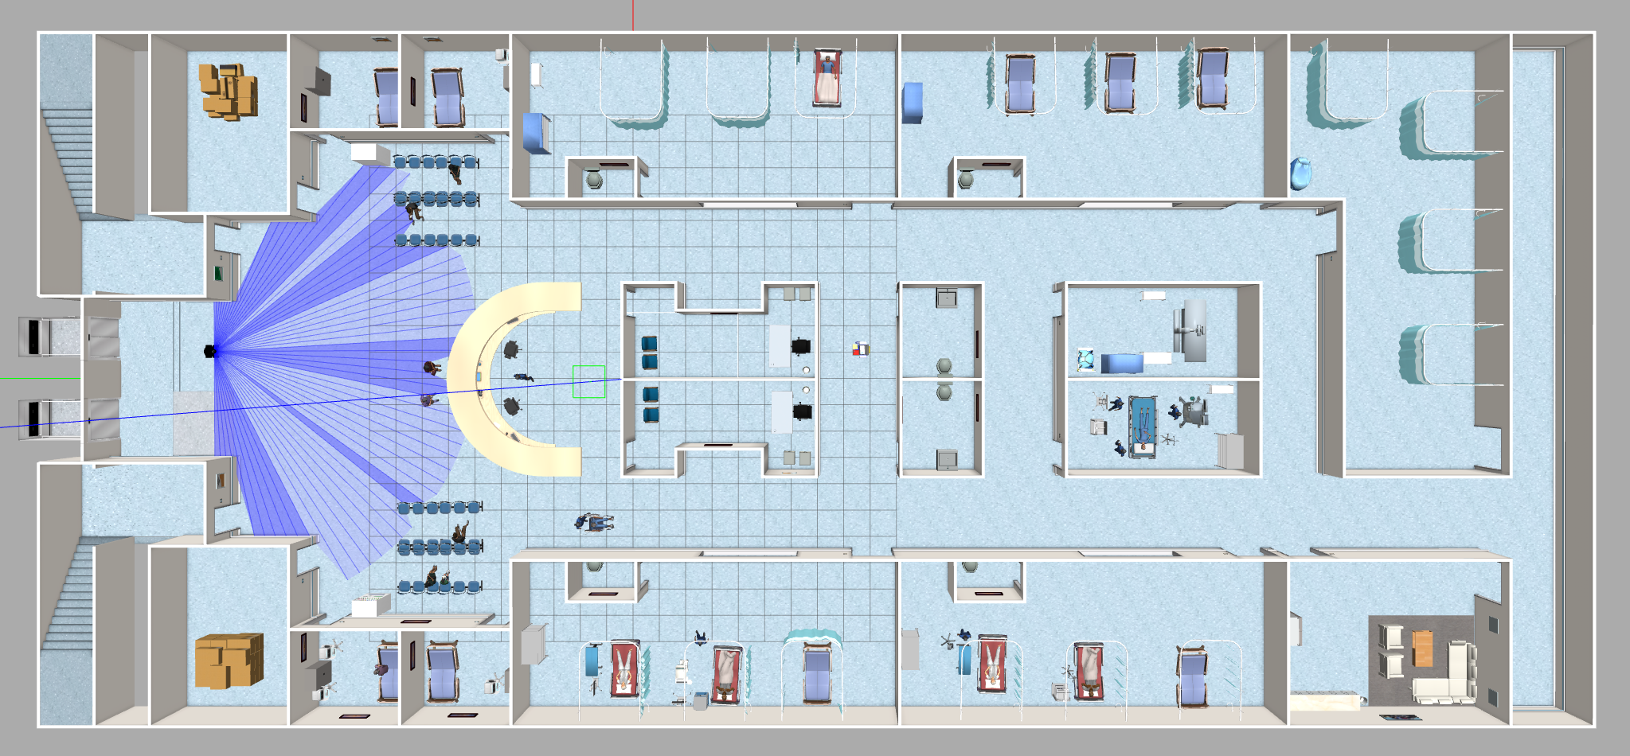
Environment Setup
Simplified Environment
Complex Environment
Note: The simulation environment was speed up by 15 times for training the agent.

Slide 6
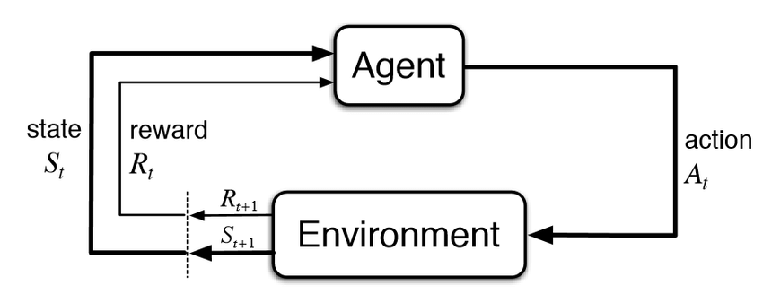
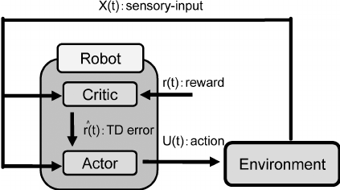
Methodology
PPO ⁽¹⁾
A2C ⁽²⁾
PPO and A2C are versatile and can handle both discrete and continuous action spaces
(1) https://medium.com/mlearning-ai/ppo-intuitive-guide-to-state-of-the-art-reinforcement-learning-410a41cb675b
(2) https://steemit.com/a3c/@calclavia/reinforcement-learning-using-asynchronous-advantage-actor-critic
Notes:
DQN is primarily designed for discrete action spaces, although extensions like DDPG (Deep Deterministic
Policy Gradients) can handle continuous action spaces.

Slide 7
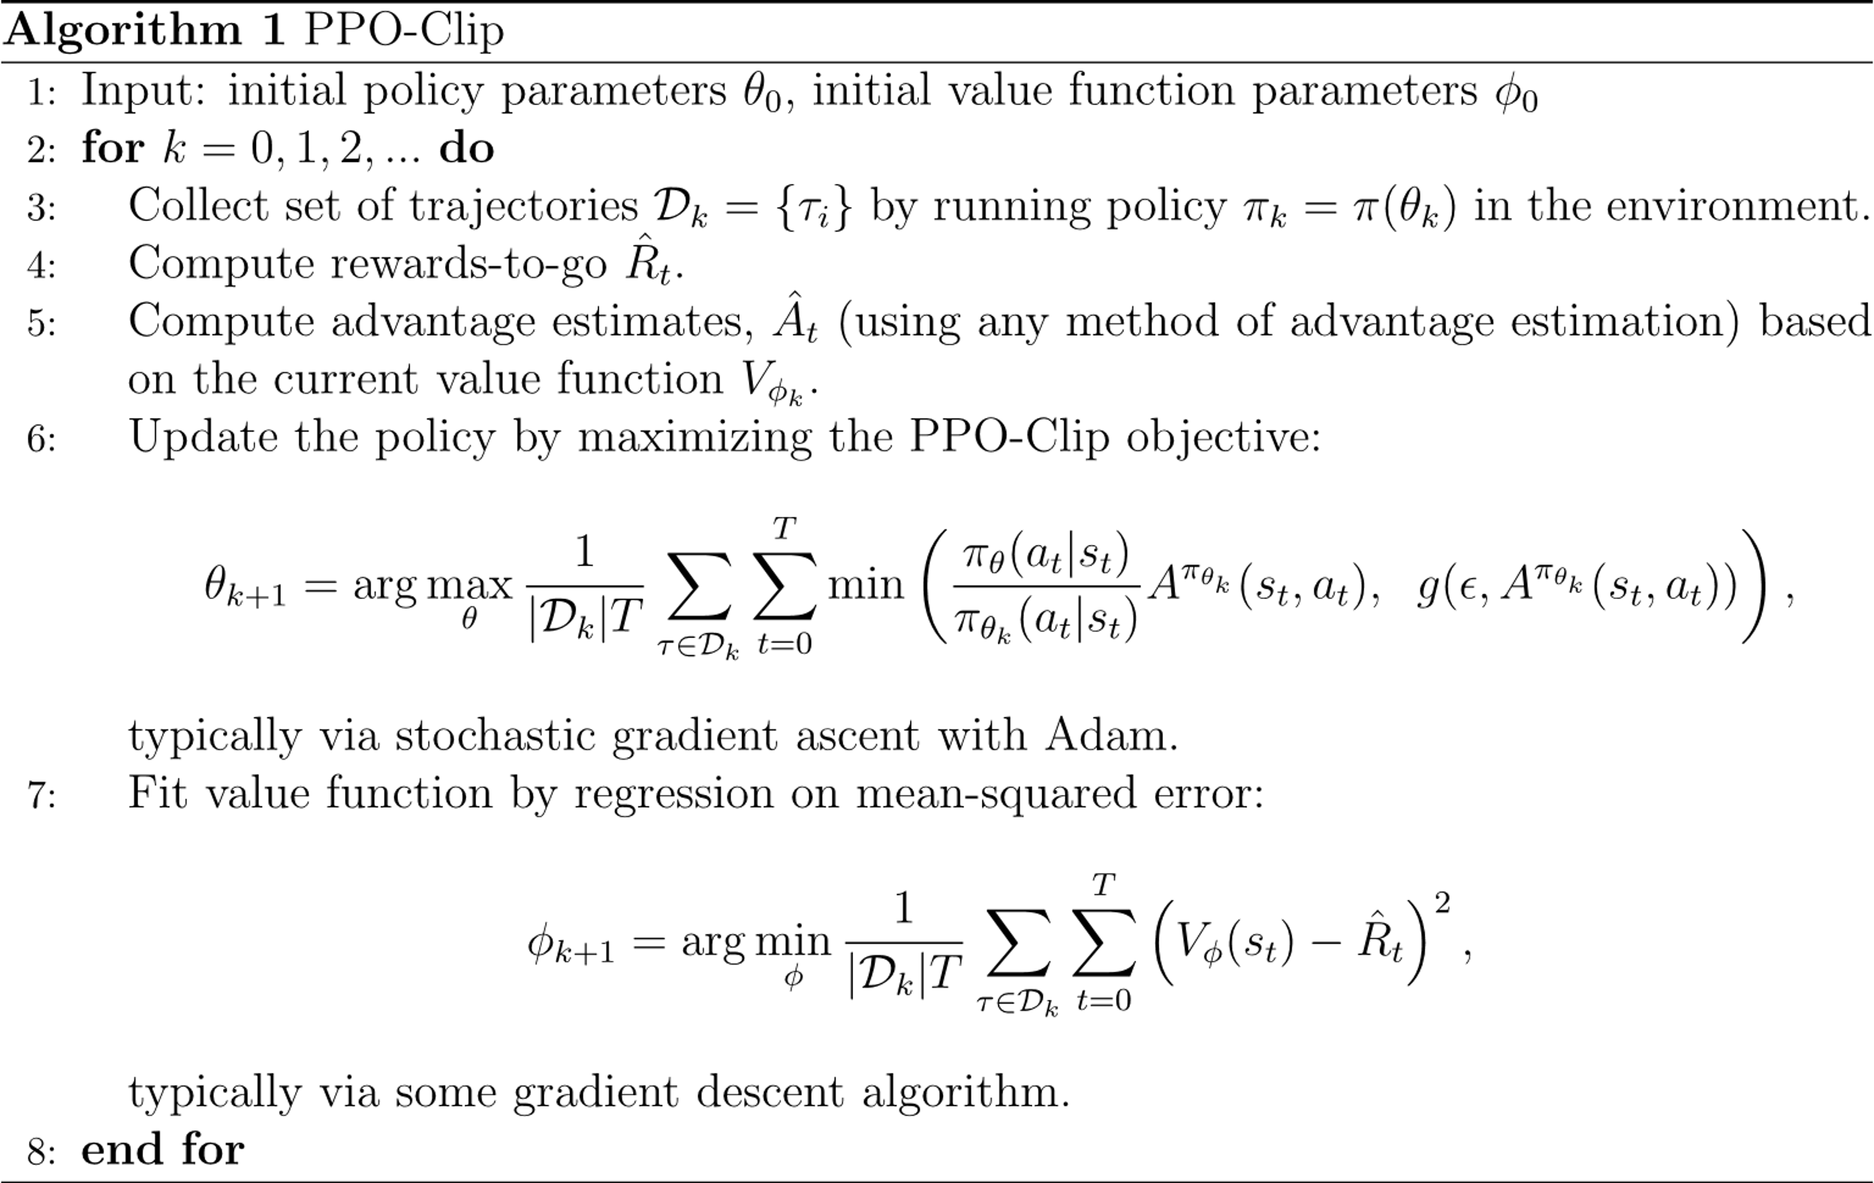
Methodology – PPO Clip
Why PPO Clip?
Simplicity of Implementation
Sample Efficiency
Stability in Training
Consistent Performance
How did perform?
Navigated avoiding collision
Successfully reached designated goal
Notes:
Simplicity of Implementation:
Compared to some more complex algorithms, PPO is relatively straightforward to implement. This simplicity can be advantageous when working on a project with practical constraints and a need for an efficient and manageable implementation.
Sample Efficiency:
PPO is known for its sample efficiency, which means it can achieve good performance with relatively fewer samples compared to some other reinforcement learning algorithms. In robotics applications, where collecting real-world samples can be resource-intensive, sample efficiency is a crucial consideration.
Stability in Training:
PPO includes a clipping mechanism in its objective function that helps to stabilize training by constraining the policy updates. This stability is important in robotics scenarios where robustness and reliability are critical.
Consistent Performance:
PPO often exhibits consistent and reliable performance across various tasks and environments. In the context of path planning for robotic navigation, having a method that consistently generates effective paths is crucial for the success of the system.

Slide 8
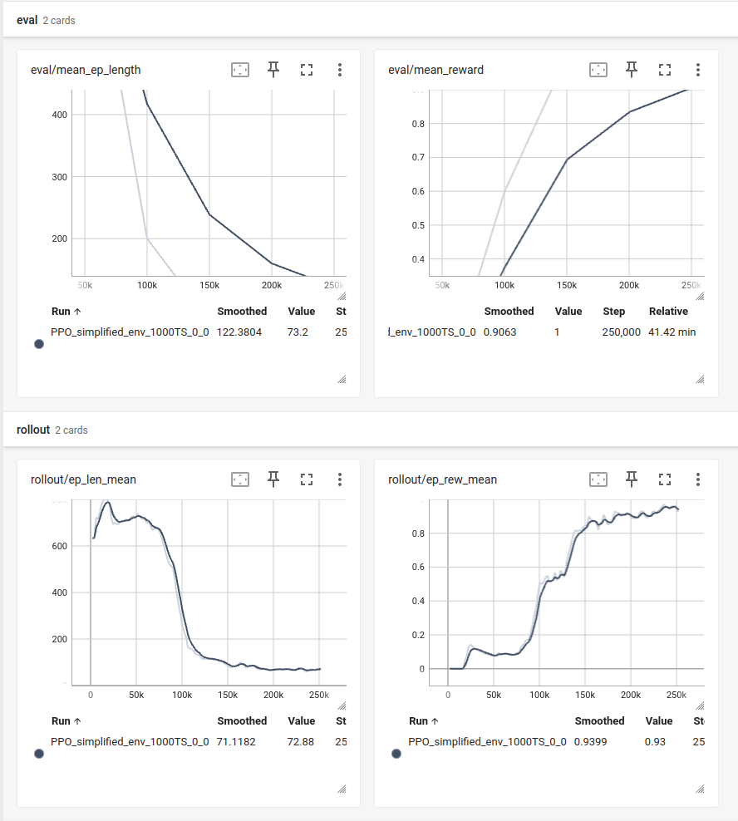
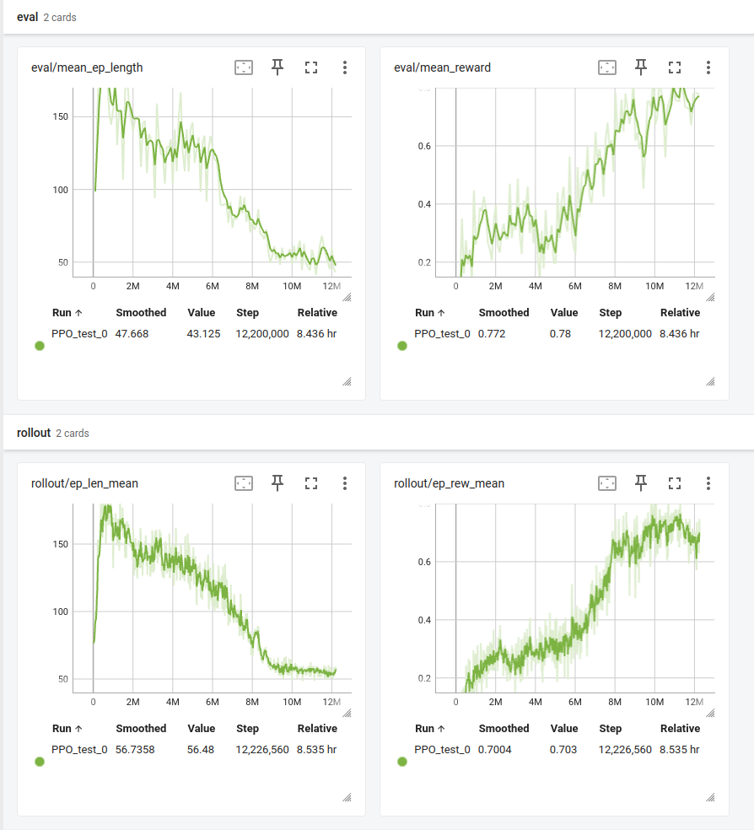
PPO Clip – Training Performance
Simplified Environment
Complex Environment

Slide 9
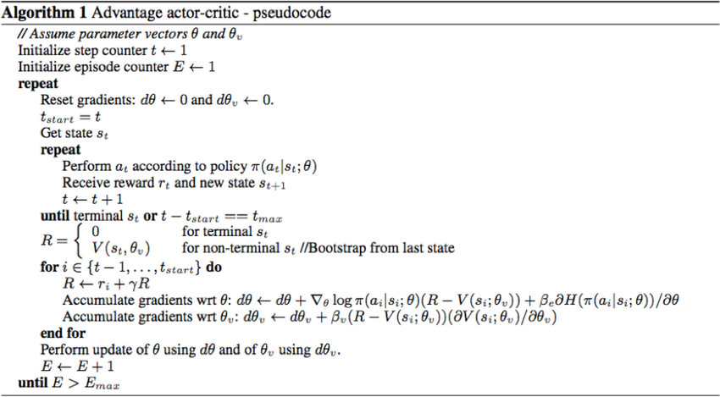
Methodology - Advantage Actor-Critic
Why A2C ?
Sequential Decision Making
Combining Value and Policy Learning
Adaptability
How did perform?
Navigated avoiding collision
Failed to reach designated goal
Limitations:
Training Time and Iterations: A2C requires a significant amount of training time and iterations to converge to optimal or near-optimal policies
Notes:
Sequential Decision Making: Mobile robots often operate in dynamic environments where they need to make a sequence of decisions over time to achieve a goal. A2C, being a sequential decision-making algorithm, is designed to handle such scenarios.
Combining Value and Policy Learning: A2C combines the advantages of both value-based methods (e.g., Q-learning) and policy-based methods. It maintains both a value function (critic) and a policy (actor), allowing for a more stable and efficient learning process.
Efficient Exploration-Exploitation Tradeoff: A2C includes a mechanism to balance exploration and exploitation. This is crucial for a mobile robot in an environment where it needs to explore to discover optimal paths but also exploit known information to achieve its goals efficiently.
Adaptability: A2C is adaptable to different types of problems and can handle continuous action spaces, making it suitable for motion planning tasks where the robot's actions may be continuous.

Slide 10
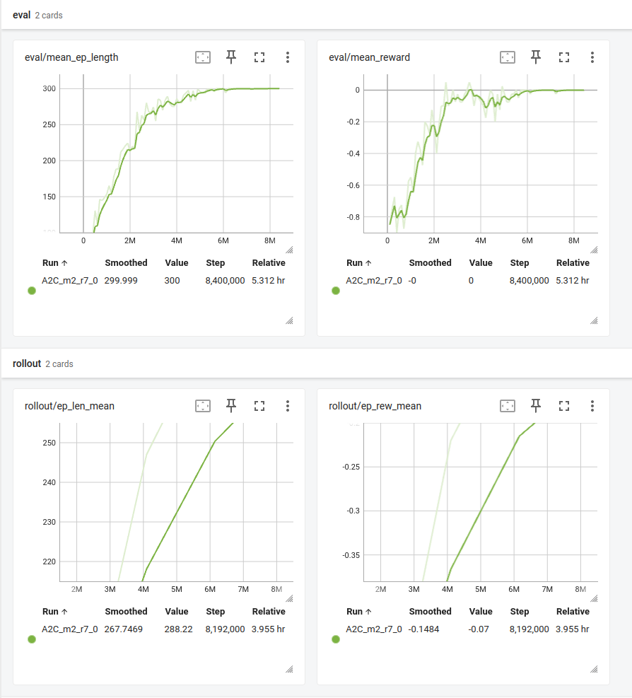
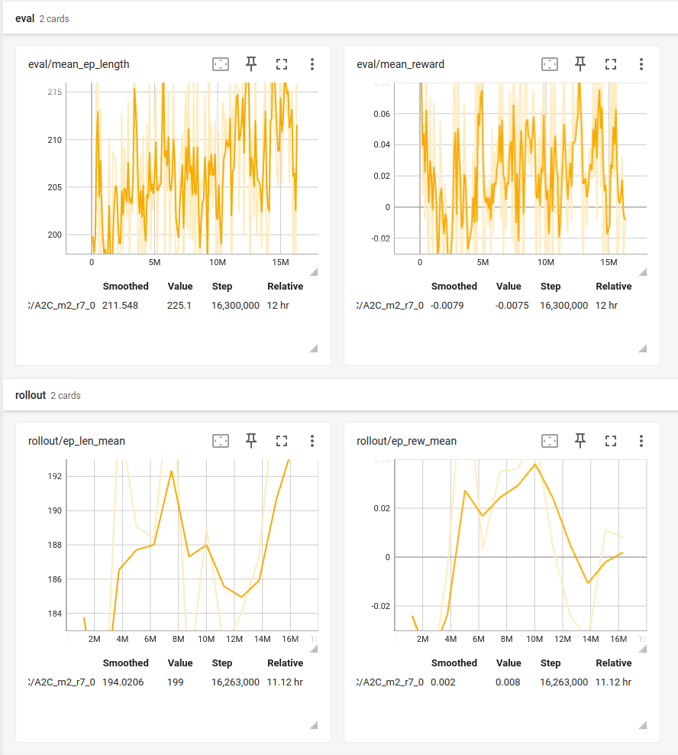
A2C Training Performance
Complex Environment

Slide 11
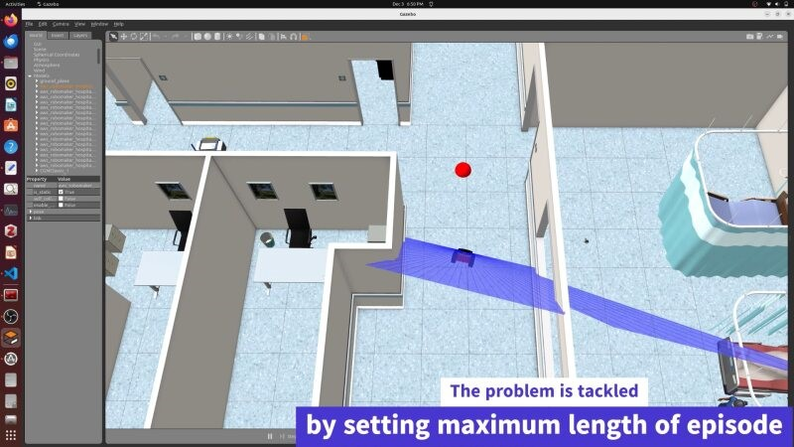
Results

Slide 12
Results
 | Training steps (in million) | Mean Episode Length | Mean Reward
Simple Environment | 2.5 | 73.2 | 1
Complex Environment, PPO | 12.2 | 43.125 | 0.78
Complex Environment, A2C | 8.4 | 300 | 0
*Maximum Episode Length =300
Consideration :
Success in reaching to designated goal
Success in Navigating the environment avoiding collision
Optimality of Path

Slide 13
Conclusion and Future Scope
Conclusion
We designed two environments - a simplified and a complex one, with the latter featuring more obstacles than the former. In our experiments, the Proximal Policy Optimization with Clip (PPO-Clip) algorithm demonstrated superior performance compared to the Advantage Actor-Critic (A2C) algorithm in both environments.
Future Scope
Enhancing the agent's performance could be achieved through refining the reward function to be more specific or by incorporating a more diverse range of episodes in the training setting. However, owing to the constraints of the present study, additional research is necessary to pinpoint an optimal learning environment configuration.

Slide 14
References
Faust, A., Ramirez, O., and Fiser, M., “PRM-RL: Long-range Robotic Navigation Tasks by Combining Reinforcement Learning and Sampling-based Planning,” IEEE International Conference on Robotics and Automation (ICRA), 2018, arXiv:1710.03937, Nov 2017.
Tai, L., Paolo, G., and Liu, M., “Virtual-to-real deep reinforcement learning: Continuous control of mobile robots for mapless navigation,” 2017 IEEE/RSJ International Conference on Intelligent Robots and Systems (IROS), Sep 2017.
Pfeiffer, M., Schaeuble, M., and Nieto, J., “From Perception to Decision: A Data-driven Approach to End-to-end Motion Planning for Autonomous Ground Robots,” 2017 IEEE International Conference on Robotics and Automation (ICRA), May 2017.
Tzeng, E., Devin, C., and Hoffman, J., “Adapting Deep Visuomotor Representations with Weak Pairwise Constraints,” under submission, arXiv:1511.07111, May 2017.
Schulman J., Wolski F., Dhariwal P., Radford A., Klimov O., “Proximal Policy Optimization Algorithms”.
V. Mnih, A. Puigdom`enech Badia, M. Mirza, A. Graves, T. P. Lillicrap, T. Harley, D. Silver, and K. Kavukcuoglu, “Asynchronous Methods for Deep Reinforcement Learning,” CoRR, vol. abs/1602.01783, 2016. [Online].

Slide 15
THANK YOU!

Slide 16
Content
Introduction
Problem Statement
Environment Setup
Methodology
Results
Challenges
Conclusion
Future Scope
References

Slide 17
Reinforcement Learning for Short Range Path Planning in Indoor Environment
Prof. Yanhua Li
Presented By: Vaibhav Kadam Shambhuraj Mane Shreya Bang
Prasanna Natu

Slide 18



Introduction
Fundamental task of robotics is planning collision free motion amongst obstacles in high dimensional spaces and complex environments.
Classical approaches uses path planning algorithm like A*, Rapidly Exploring Random Trees, Sampling based Planning etc.
We explore short range path planning by leveraging advanced techniques like Proximal Policy Optimization (PPO) and Advantage Actor-Critic (A2C) to navigate through complex hospital environments.

Slide 19
WHY Learning-Based Approaches?
Adaptability to Uncertainty
Learning from Experience
Generalization Across Tasks
Real-world Robotic Systems

Slide 20
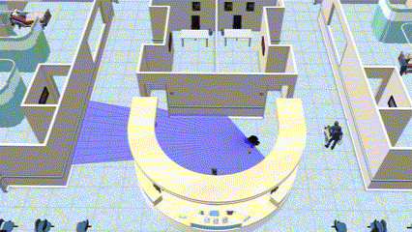
Problem Statement
To train an RL agent to navigate short distances within a simulated environment, without prior knowledge of the space’s large -scale topology avoiding obstacles considering robot constraints.

